Slide 1
Becher Point Wetlands
By Harry Chamberlain

Slide 2
What is a wetland?
A wetland is a space or area that is covered with mostly water or is saturated with water, this can be by seasons or just permanently- Nat Geo Society
Examples of wetlands include lakes, rivers and creeks
They are important because they’re home to multiple common animals such as fishes, frogs, turtles and plants. They also are important for when birds migrate.

Slide 3
What is the Ramsar Convention?
Most commonly known as being the first modern treaty in which their aim is to conserve and protect our natural resources which is why it makes it more important for us. The convention got its name after the town in Iran what’re the treaty took place in 1971

Slide 4
Ramsar Criteria
Becher Point Wetlands are qualified in criterion 1 and 2
Criterion 1: A wetland should be considered internationally important if it contains a representative range, rare or unique example of a natural or near-natural wetland type found within the appropriate biogeographic location - environment.gov.au
Criterion 2: A wetland should be considered internationally important if it supports vulnerable, endangered or critically endangered species or threatened ecological communities - environment.gov.au

Slide 5
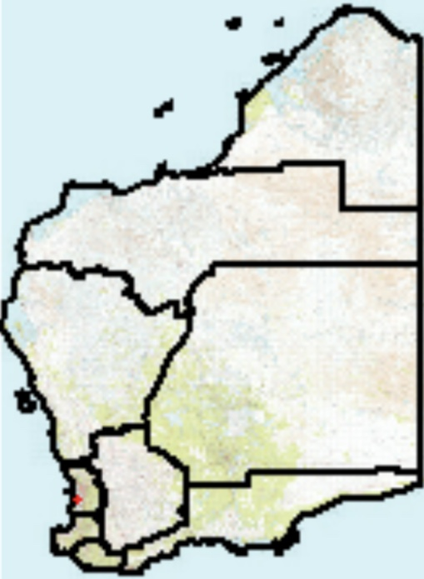
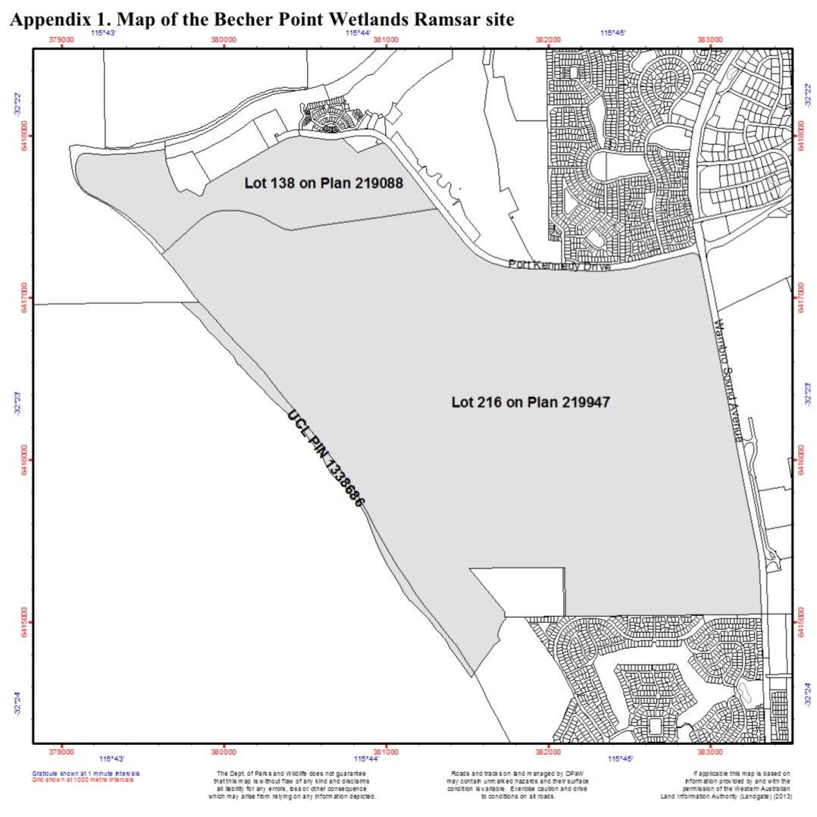
Where it’s located

Slide 6
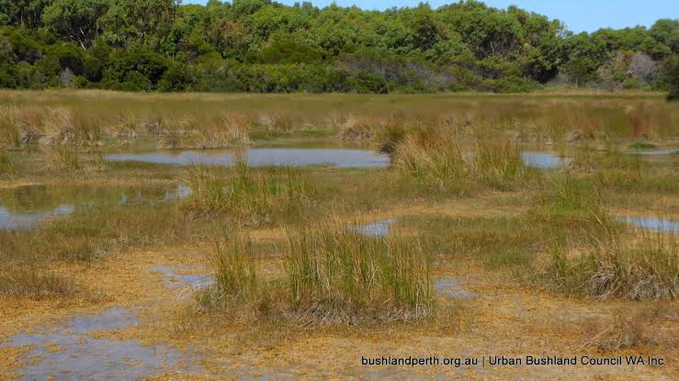
Key features
The biographic region on Becher Point wetlands is in the South West Coast drainage division. The wetland is seasonal and are also known as sumplands and damplands. Seasonal recharge of the wetlands is derived from rainfall and groundwater. In the average rainfall year, the sumplands arise to a depth of 10-50cm for around 1-4 months.

Slide 7
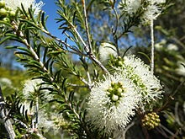
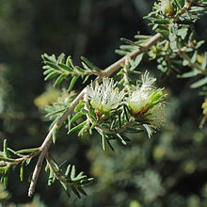
Flora
Melaleuca Raphiophylla- Commonly known as the swamp paperbark, this plant is a part of the myrtle family. It has narrow needle-like leaves and profuse spikes of white
Melaleuca Cuticularis- Commonly known as the saltwater paperbark, this tree is a part of the myrtle family. It is distinguished from other melaleucas by its unusual fruits and very white, papery bark.

Slide 8
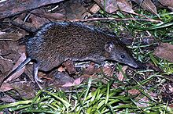
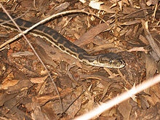
Fauna
Southern Brown Bandicoot- A type of marsupial that is mainly found in the south area of Australia
Southern Carpet Python- A large snake found in the southern regions, also known as the Morelia Spilota Imbricuta

Slide 9
Social and cultural values
The Rockingham Naturalists’ Group, WA Wildflower Society and Royal Society of WA host excursions with children for educational purposes and school.
The Wetland also had an old Artillery range that was used for soldiers in WWII

Slide 10
Bibliography
https://www.dpaw.wa.gov.au/management/wetlands
https://www.environment.gov.au/water/wetlands/ramsar/criteria-identifying-wetlands
https://www.environment.gov.au/cgi-bin/wetlands/ramsardetails.pl?refcode=54
http://www.environment.gov.au/water/topics/wetlands/database/pubs/54-ris.pdf
https://en.m.wikipedia.org/wiki/Becher_Point_Wetlands

